Slide 1
Racism
By: John Nash

Slide 2
What is racism?
It is: “The systematized oppression of one race of another. In other words, the various forms of oppression within every sphere of social relations—economic exploitation, military subjugation, political subordination, cultural devaluation, psychological violation, sexual degradation, verbal abuse, etc.—together make up a whole of interacting and developing processes which operate so normally and naturally and are so much a part of the existing institutions of society that the individuals involved are barely conscious of their operation” -James Boggs

Slide 3
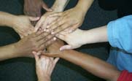
Is racism only based on color?

Slide 4
Is racism only based on color?
No, it could be based on either of:
- Racial injustice
- Economical Injustice
- Religious injustice
- Gender injustice

Slide 5
What does racism do?
It divides people
Violates human dignity
Deprives people of their rights
Creates hate and injustice
Corrupts the morality of the society

Slide 6
Is racism over?

Slide 7
Not yet!!
We have laws against racism
We have a good awareness compared to past
We have more acceptance of the minorities
BUT
Still a long way to go

Slide 8
Following areas still have racism
Employment
Education
Housing

Slide 9
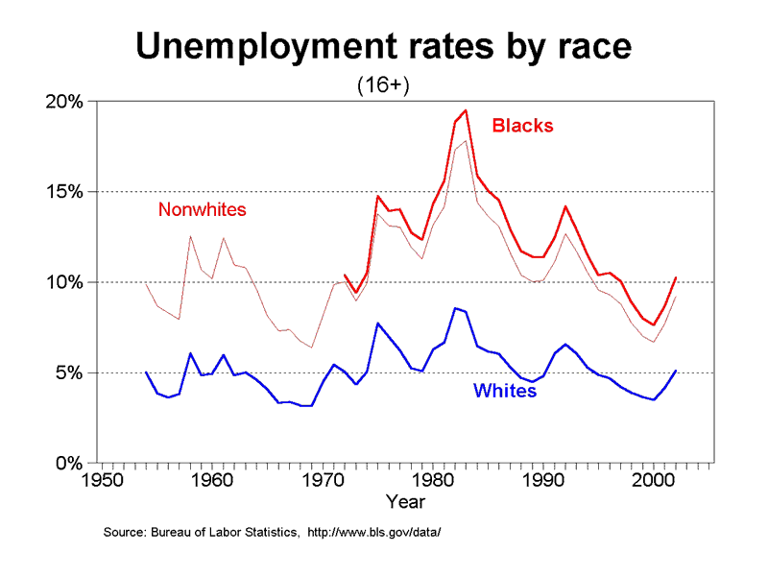

Slide 10
Thank You!

