Slide 2
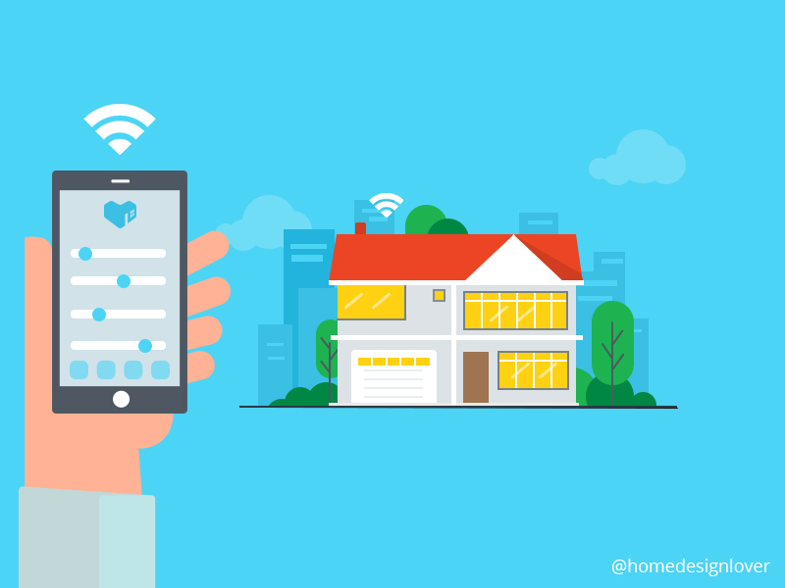
What are smart homes?
Smart homes are homes equipped with network-connected products and connected via Wi-Fi, Bluetooth, or similar functions.
Homes equipped with lighting, heating, and electronic devices to be controlled remotely by phones, tablets or computers of the home owner/s.
Homes managed without the need of manual labor or the physical necessity of humans.

Slide 3
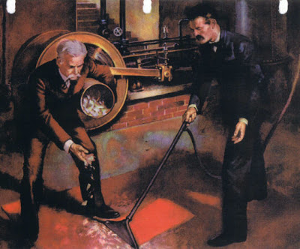
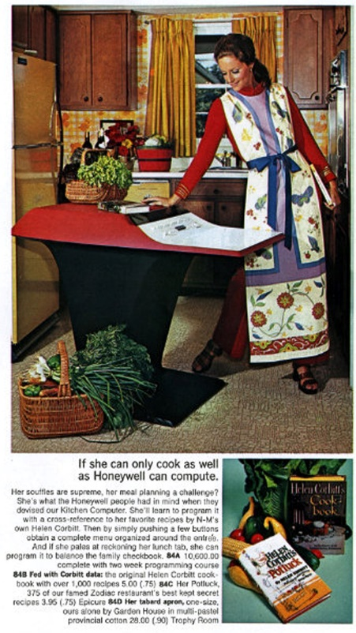
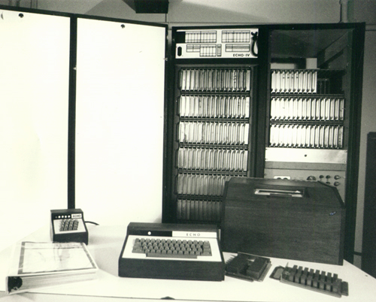
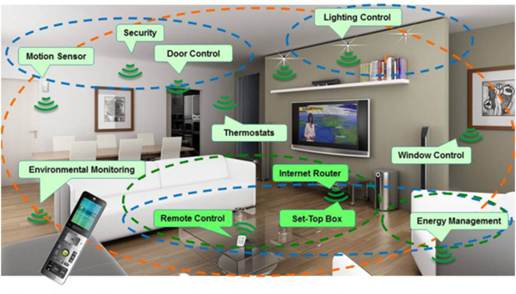
Historical background
The idea of smart homes can be originated in the start of 1900s, when the first engine-powered vacuums came out in 1901, invented by British engineer Hubert Cecil Booth and American inventor David T. Kenney, to clean without much manual labor and less time-consuming. The idea of convenience grew with the invention of refrigerators, clothes dryers, washing machines, toasters, and more in the first two decades of 1900s.
The first smart device was created in 1966 and called the ECHO IV. ECHO IV could compute shopping lists, control the temperature at home and turn appliances on and off. It was never commercially sold.
The kitchen computer was developed a year later (1967) for storing recipes and using them later. It didn’t sold well due to an tagline, “If she can only cook as well as Honeywell can computer”.
Smart homes, or home automation, started to gain popularity in the early 2000s and started better convenience from domestic technologies and home networking.
Current smart homes is to manage the home without the physical need to be in the home and it ranges from preparing food, setting up heating and lighting, security, and energy-usage.

Slide 4
The Cons
Hack-able. Smart homes can be hacked and stolen through the owner/s devices like their phones, computers or laptops, and tablets. This is basically someone stealing the key to your home. The hackers could potentially learn about the owner/s habits and personal information.
System compatibility. Not all systems can be compatible with others. May need multiple devices/accounts to control all the functions, if the systems aren’t compatible with one another.
The cost. The cost of a smart home is based on how smart the home should be and could go from few hundred dollars to hundreds of thousand or millions plus contractor/s to install the system if the owner/s aren’t tech savvy.
Complex technology and installation. Making a very smart home is very complex in both using it and setting it up, and could require outside help (contractor) to install and setting up the system.

Slide 5
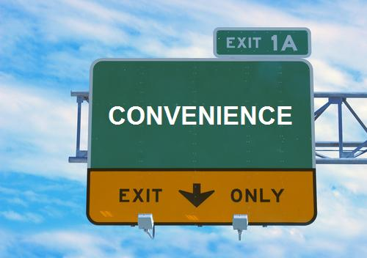
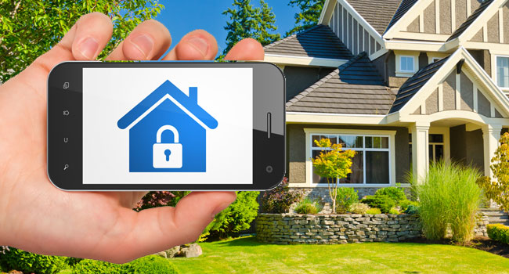
The Pros
Convenience. Being able to do activities at home without being there like cooking, cleaning, or heating. Making life more simple at home without being home.
Environmentally friendly. Heating and lighting can all be controlled and automatically for the most optical and efficient energy usage.
Saves money. Managing heating, lighting, and water by being automatically controlled saves money by using only the needed and efficient amount. It has great potential to reduce energy bills and insurance cost.
Security. Only the owner/s and invited guests will be accepted to enter. Notifies whoever is coming to the door and ringing the bell or trying to break in from miles away through the device/s connected to the home. Insurance discounts due to greater safety than regular homes.

Slide 6
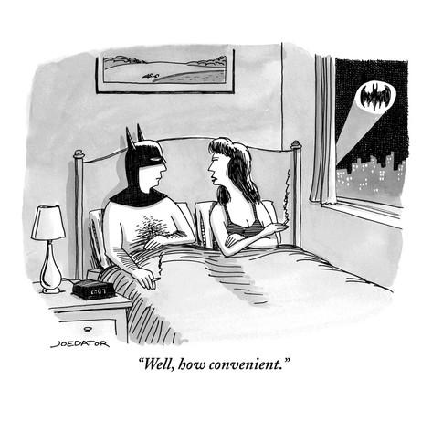
How it affects lives
Environmentally friendly and saves money through efficient and optimal usage of energy.
Great convenience and saves time without the need to managing the home and preparing certain activities like cooking or cleaning without the need to be home and manually managing it.
Can offer greater security than regular homes and lowers the risk of being robbed or intrusion by unwanted guests.

