Slide 1
ISIS

Slide 2
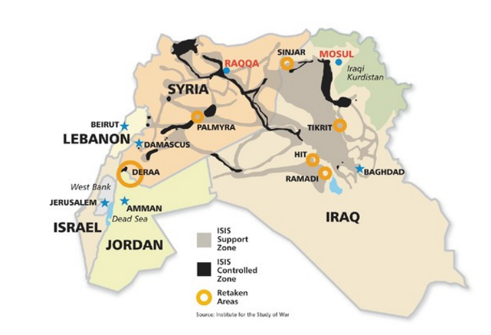
What is ISIS?
ISIS is a terrorist organization that is currently
active in different parts of the world.
Their ideology is to make an Islamic Extremist State and expand to the whole world
Currently they occupy some areas of
Syria and Iraq
http://www.barrons.com/articles/islamic-state-defeat-in-2017-1461990736

Slide 3
How ISIS was made?
Two splinter groups of Al-Qaeda , Jabhat Al-Nusra (Syria) and Islamic State of Iraq formed ISIS
They Decided Islamic State of Iraq and Syria (ISIS)
Many blame Western Powers for its creation
It was formed to topple Assad regime in Syria

Slide 4
ISIS and Caliphate
ISIS believe that All world should be under their version of strict Islamic Sharia Law
All the world should be concurred for this reason
In June 2014, it occupied area more than UK
There should be one Calipha (ruler) of the world
Current ISIS Calipha is Abu Bakr al-Baghdadi

Slide 5
ISIS Terrorist Activities in the World (2016)
ISIS claimed responsibility for the following terrorist activities but the actual number of attacks is much more:
Month | Country | Details
January | Indonesia | Suicide attack at Starbucks
January | Turkey | Targetter Foreigners at Sultanahmet Square
January | Saudi Arabia | Mahasen Mosque Attack
March | Belgium | Suicide Attack at a Metro Station and Airport
June | USA | Gay Club Attack
July | France | Nice Truck Attack

Slide 6
Almasjed el Nabawi Attack in Saudi Arabia
Almasjed el Nabawi is one of the holiest Muslim Site in Saudi Arabia
On 4 July 2016, Suicide bomber exploded in its Car Parking
This attack killed 4 people
ISIS claimed responsibility

Slide 7
Al Imam Sadiq Mosque Attack Kuwait
Suicide bombing in Al Imam Sadiq Mosque on 26 June 2015
Killed 27 People in the Attack
Suicide Bombing carried out during Friday Prayer
The mosque is used by Shia Muslims

Slide 8
Thanks!

