Slide 1
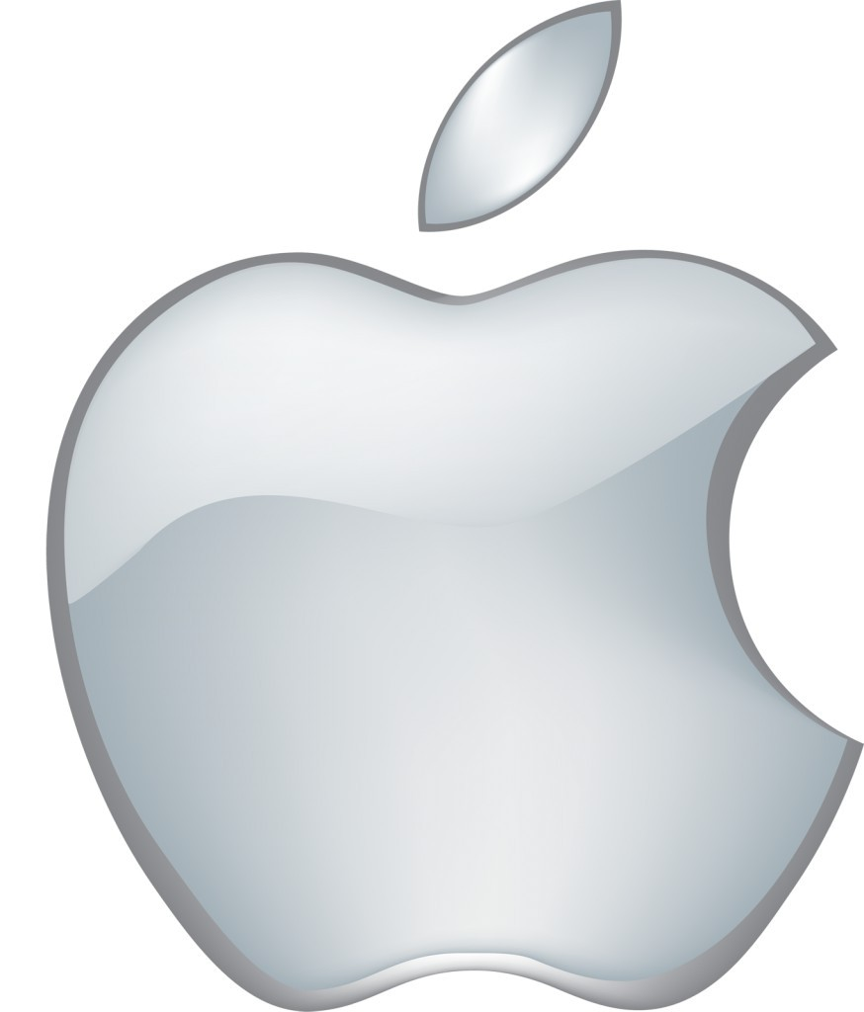
Apple Inc
Productions & Operations Management

Slide 2
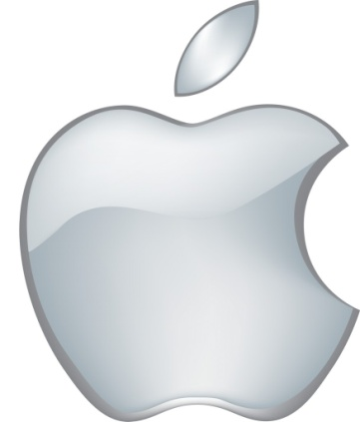
Operations Management: Apple
Apple has built a closed ecosystem
The company exercises control over the operations from design to retail store.
Operations expertise happens due to innovation and intense marketing
Production of few products which will have a high demand & competitive advantage
Notes:
The operations management of Apple is a closed ecosystem since the company has a control over the company’s supply chain management of retail stores. It has more control over the costs and value chain of the company. The technology is also integrated and built in the closed ecosystem of the company. Also the company focuses on developer ecosystem which is value adding component of the industry. The operations management has gained success because of its innovation and intense marketing strategies. Also the company focuses on making high end products that cater to the high end customers having a competitive advantage.

Slide 3
Manufacturing Plant of Apple
Located in Silicon Valley, San Francisco, United States
Has helped the company get high-tech innovation
Products which Apple manufactures are divided into six major categories- desktops, IPods, Laptops, Software, Iphones and Ipads.
Notes:
The manufacturing plant of Apple is situated in the Silicon Valley, San Francisco which is known as the technological hub of the world. Major technology and software companies are given help and support by the Silicon Valley. The location of the Apple manufacturing plant is such that it also receives a considerable amount of technological innovation and software development methodologies. Apple is currently focused on manufacturing and supplying 6 major categories of products- desktops, ipdas, iphones, software, ipods and laptops. The company has also gone through an immense change in the technological innovation sector, constantly upgrading itself to the next level. It

Slide 4
Design Structure: Apple
Apple stores are designed in such a way that
the customers are influenced and attracted to spend more.
Stores are designed and planned to attract more customers
The retail store layout is protected from copyright infringement through trademarks
The stores have an aesthetic appeal & has been designed with visual appeal.
Notes:
The design structure of Apple outlets and stores is of superior quality and great customer appeal. The retail stores are designed to create an experience for the customers, a long run experience. Whether it is the interior design or the outside appearance of the store, Apple has made sure that the ongoing customers while passing by, are compelled to have a look at the store. The stores are equipped and designed in such a manner that they aim at delivering a high quality shopping experience. I feel that the company exhibits a “story within the store” concept which is unique and hence the retail stores have gained so much attraction and local relevance.
Apple has also gotten itself trademarks and copyrights to avoid any false and fake stores design and layout. (Ribeiro, 2015)

Slide 5
Successful Strategies Of Apple
Pricing products to customer segments: High margin customers first then price conscious customers
Creation of high expectations and developing “the next big thing”.
Catering to precise customer needs and opinions
Notes:
The successful strategies of Apple include its unique selling proposition which is it is very clear in its approach. It caters to high end customers who are looking for a superior quality-luxury product. They first want to fulfil the demand of these customers then move on to the other price conscious customers. The company also creates high expectations regarding the “next big thing” which keeps its customers guessing and in anticipation of something new and innovative. (Stark & Stewart, n.d.)The company believes in delivery precise goods that are relevant and in demand to the customers, which has been a successful business strategy of the company. (Nielson, 2014)

Slide 6
Value Chain Analysis
Inbound logistics Infrastructure
Operations HRM
Outbound logistics Technology
Marketing & sales
Customer Services
PRIMARY ACTIVITIES
SUPPORT ACTIVITIES
Notes:
The value chain analysis of the company includes 2 major activities- primary and support. The primary activities includes- operations, logistics, marketing, sales and other services. These activities formulate the supply chain management of the company. The supply chain and distribution management is also carefully executed and implemented by the inventory components. Apple usually uses the Integrated Marketing Communication approach for its Marketing and Sales department. Lastly the customers services involve the after sales services and Customer Relationship Management which the company has to maintain to have a long term relationship with existing and potential customers along with customer loyalty. The support activities include- Human Resources Management, Infrastructure services and Technology.
(Dudovskiy, 2015)

Slide 7
Supply Chain Model: Apple
SOURCING
WAREHOUSING
MANUFACTURING
DISTRIBUTION
RETURN
Notes:
The supply chain model of the company includes- sourcing which is the origin of the manufacturing and where the product is being produced- national and international. Secondly the model includes the manufacturing section where the production of the products is done and assembled. Next is the warehousing where the finished goods and raw materials are stored carefully so that distribution can happen easily. From the warehouses itself, the finished goods can reach the online stores, retail stores, wholesalers and retailers. This is the process of distribution that takes place and Apple needs to maintain high level of networking and distribution so that the goods reach the consumer. Lastly the return process takes places if there is any scope of defect of faults in the products that are found by the distributors or customers. (Supplychainopz.com, n.d.)

Slide 8
Challenges of Apple’s Supply chain management
Global economy
Disloyalty from distributors and resellers
Obsolete inventories
Custom components might not be available
Supply chain might be disrupted due to natural disasters
Reliance on outsource manufacturers and distributors
Misuse of supply chain code of conduct
Notes:
There are certain challenges which the supply chain management of Apple can face like- the global economy changes, the resellers and suppliers might misuse information and work for the competitors, the inventories might turn bad and reduce in quality, there are certain components that are customized which might not be available, there may be certain natural disasters and violation of suppliers code of conduct. These may lead to Apple facing supply chain disruption. (Supplychainopz.com, n.d.)

Slide 9
Apple’s Competitive Advantage
Apple Inc is the world leader in Innovation, Branding and Software Ecosystem.
Sustainable operating system
Apple’s Retail Strategy
iTunes & Digital Asset Management
Apple’s Hardware + Software
Notes:
Apple’s competitive advantage lies in various segments like innovation, goodwill, technology, software ecosystem, efficient operating system, retail and distribution strategy & digital asset management. These and many more reasons have led to Apple being a superior brand name globally. Its operations management, supply chain and distribution management have helped it gain a steady momentum in the market. It faces competition from Samsung and Android but even then it has gained a strong competitive advantage by using its resources well and strategizing them properly. (Nielson, 2014)

Slide 10
References
Dudovskiy, J. (2015). Apple Value-Chain Analysis - Research Methodology. Research-methodology.net. Retrieved 14 July 2015, from http://research-methodology.net/apple-value-chain-analysis/
Nielson, S. (2014). Apple's premium pricing strategy and product differentiation - Market Realist.Marketrealist.com. Retrieved 14 July 2015, from http://marketrealist.com/2014/02/apples-premium-pricing-strategy-product-differentiation/
Ribeiro, J. (2015). Apple gets trademark for retail store design and layout. Computerworld. Retrieved 14 July 2015, from http://www.computerworld.com/article/2494903/it-management/apple-gets-trademark-for-retail-store-design-and-layout.html
Stark, K., & Stewart, B. 3 Strategies to Adopt From Apple. Inc.com. Retrieved 14 July 2015, from http://www.inc.com/karl-and-bill/3-strategies-to-adopt-from-apple.html
Supplychainopz.com,. Is Apple Supply Chain Really the No. 1? A Case Study. Retrieved 14 July 2015, from http://www.supplychainopz.com/2013/01/is-apple-supply-chain-really-no-1-case.html

