Slide 1
Larry Page (Co-founder & CEO Google Inc.)

Slide 2
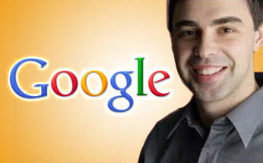
Introduction
Lawrence “Larry” Page (born March 26, 1973)
Born in East Lansing, Michigan, United States
Computer Scientist and Internet Entrepreneur
PHD Scholar Stanford University
Co-founder & CEO Google Inc.

Slide 3
BackRub to Google
BackRub, Larry Page PHD research project
BackRub an effective internet search initiative
Google’s co-founder Seegey Brin joined Larry in the BackRub project
Google registered as a company in 1998
Based on advanced BackRub, Google has the largest internet page indexing in the world
Google other projects: Google Earth, Google Adsense, Google Chrome, Google Maps, Google Android etc.

Slide 4
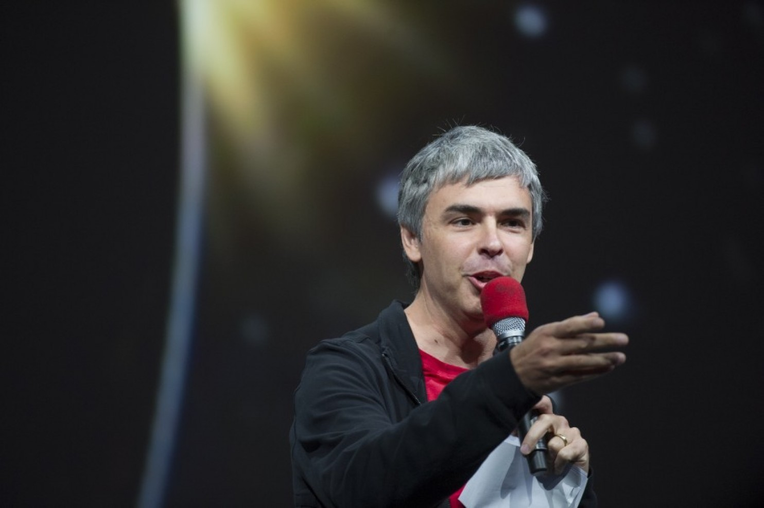
Leadership Style
Don't delegate
Don't get in the way if you're not adding value
Don't be a bureaucrat
Ideas are more important than age
Don’t stop others unless you can help

Slide 5
Leadership Traits
Commitment and communication
Innovative
Futuristic
Pervasive
Appreciates ideas by subordinates

Slide 6
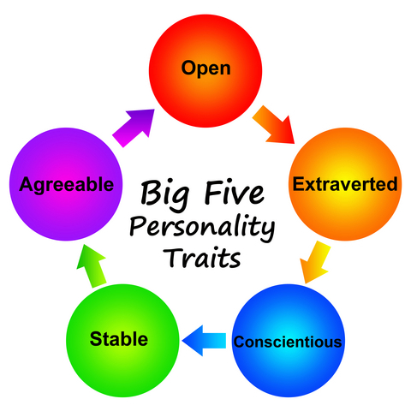
Big Five Personality Traits
Larry Page has two of the Big Five Personality Traits:
Openness to Experience
Larry Page believes in trying new things,
initiated many projects, futuristic.
Extroversion
Larry Page is energetic, discusses ideas,
good communicator

Slide 7
Conclusion
Larry Page is one of the great Entrepreneurial Leader of the modern world. He has revolutionized the internet business industry by letting people reach the information they need from billions of webpages available online. Google is the largest employer of the world. He is kind of an Entrepreneur who enabled hundreds of thousands other online entrepreneurs earn from their websites with the help of Google AdSense scheme.
Larry Page would be an inspiration for future inventors and entrepreneurs for a long time.

