Slide 1

COMPUTER ENGINEERING

Slide 2
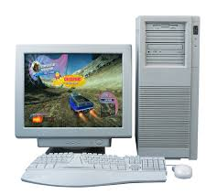
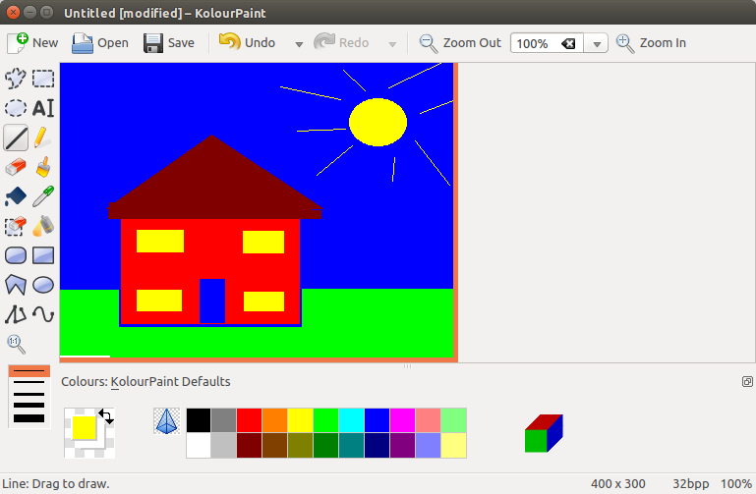
My Career Choice
I found Computers to be the most exciting machines in the world during the early school years because it would do many things amazingly for me. For example Typing, calculations, paint, Word Art.
I started doing basic editing and designing using Word Art and MS Paint with my PC when I was in school.
Internet was another wonderful thing that I came across through the computer and I started learning new things with it.
This increased my interest in Computers and I used to think that I must do something in Computers

Slide 3
Computer Engineering –Career Choice
To stay in touch with the wonders of Computers, I choose to do Computer Engineering in the USA because I did not see any good teaching and learning resources in my country.
My choice of Computer Engineering as a career has been strengthened by the everyday new innovations and computer applications in each and every field of life.
Artificial intelligence, networking, programming, android and window phone apps, Geographical Information System Apps, graphic designing, and virtual reality are different exciting areas which have brought the world to this level modern technologies and still there is not limit on the new innovations.

Slide 4

Why Computer Engineering?
Money is the need of the day. One who earns more, can contributed more to the society.
One of the motives behind my career choice is money as it will enable me to help people around me, live a healthy and luxurious life, as well as I will be able to do a lot for the humanity.
A recent survey stated that Computing professionals earn around 100,000$ per year which higher than any other profession.
I plan to start my own charity once I start earning a good amount of money

Slide 5
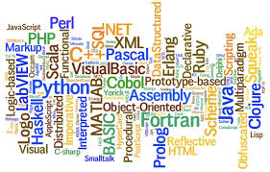
Why Computer Engineering?
Computer Engineering involves programming which is not only required in computer engineering but in almost every field of life now a days.
President Barak Obama in his speech said, in near future every one in the world would need to know “Coding” as it is the need of the day.
I explored that he is very right about it. I was surprised to know that MATLAB programming is used in psychology field. Similarly, everywhere Coding is making its place.
Earth sciences fields involve Geographical Information Systems which again require programming and web programming skills. So programming in computer engineering will make me fit for many fields of life.

Slide 6

Computer Security
Within computer engineering, I plan to specialize in Computer Security.
Due to the applications of computer technology in ecommerce and banking and du to the sensitivity of information that people use on networks and computers, networks and computer security has become crucial.
Computer and network security experts are earning highest among computing professionals.
The value of computer and network security professionals is because they are the ones who make individuals and businesses make secure transactions without worrying about loss of money or leakage of information.

Slide 7
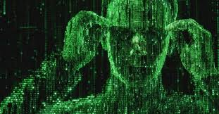
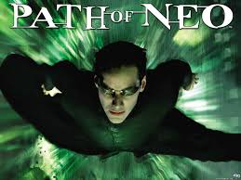
Matrix Movie
Matrix movie represents very interesting and exciting aspects of computing world and security.
The movie talks about a character Neo who is a computer security professional and hero of the movie. He represents the character of an ethical hacker or security expert. While villain of the movie is a bad hacker.
Neo is always making security solutions and villain is busy hacking the system to break into the secure information and controls of the world.
Besides that, the movie also shows high quality graphics which is another aspect of computer engineering.

Slide 8
Matrix and computing world
The computing world is similar as presented in the Movie.
My friend Ahmad is a computing security expert and he always talks the same things that he is always busy in keeping check on hackers.
His duty is to keep the system secure against intruders. For this purpose he not only has to solve the problems that are going on with the networks, but he also has to sit and think of new solutions to protect the system in advance.
This fight between the hackers and the security experts is a continuous process where intruders find new ways, security experts develop new solutions.
This beauty of the computer world attracts me more to study, learn and practice while staying in the computer engineering field.

Slide 9

Thanks

